Slide 1
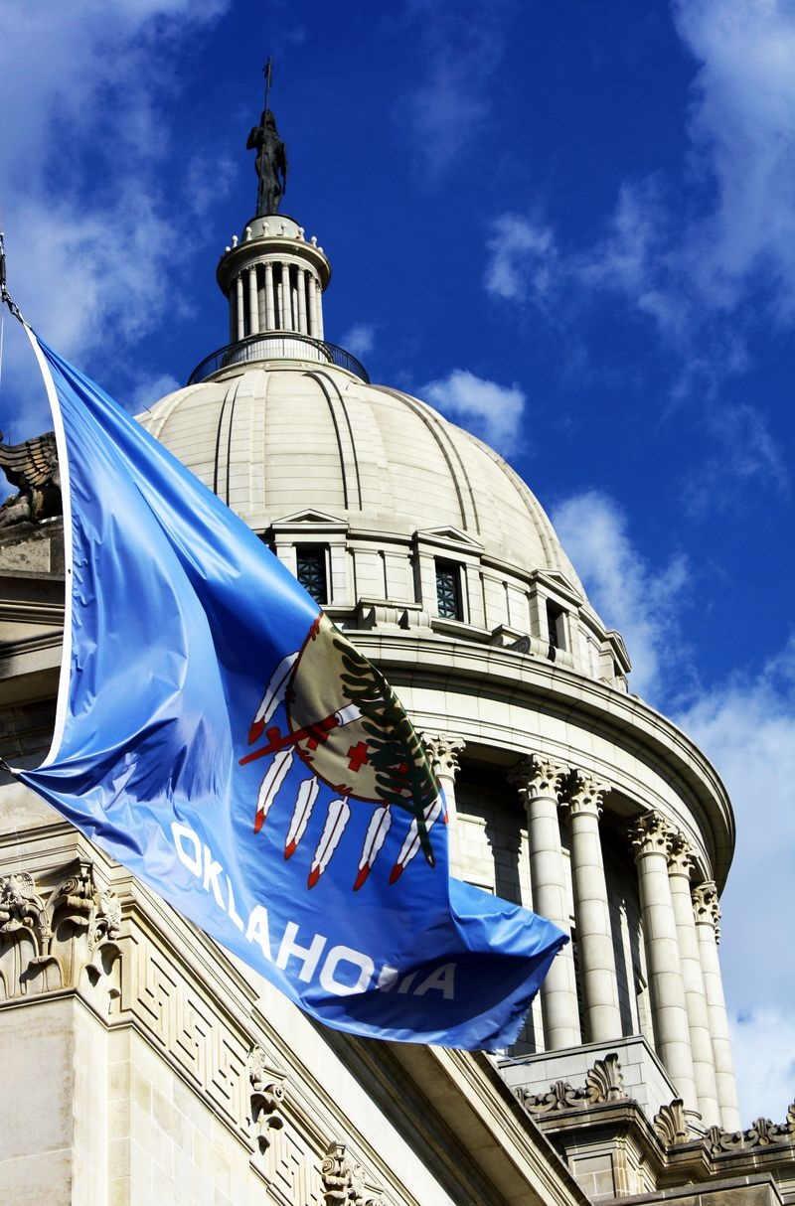
The Advocate’s Guide to Effective policy change
Joe Dorman, CEO
Oklahoma Institute for Child Advocacy

Slide 2
Why is advocacy important?
What is advocacy? | Why is advocacy important? | How can you be an advocate?
Advocacy is the process of making your voice heard effectively on issues that impact our lives
When done effectively, advocacy influences public policy by providing a way for individuals and organizations to voice their opinion and possibly move policy makers to respond to constituents’ needs
The first step to being an effective advocate is understanding how the political system works in Oklahoma. It is also important to understand what you can legally do when visiting with policymakers

Slide 3
Advocacy vs. Activism vs. lobbying
Advocacy *Advocacy is process of making your voices heard on issues that affect our lives. *Provide information for adoption or rejection of legislation. *Urge the public to contact policy makers to advocate for adoption or rejection of legislation. *Nonprofits and service agencies can and most engage in advocacy to achieve their goals/mission. *Helps policymakers find solutions to problems. Example – inform a lawmaker about a policy impact or outcome | Activism * Activism is a doctrine or practice that emphasizes direct vigorous action especially in support of or opposition to one side of a controversial issue. *Engage on a policy issue through various means of outreach, including public protests. *Encourages Public outcry for promotion or opposition to a public policy. *Nonprofits and service agencies can and sometimes engage in activism efforts to achieve their goals/missions. *Oftentimes come into conflict with policymakers. Example – The protest at the Capitol saw people march for the outcome | Lobbying *Involves activities in direct support of or opposition to a specific piece of introduced legislation. *Nonprofits can engage in some lobbying (up to 20% of budget). *The IRS has strict rules about the portion of a nonprofit’s budget that can go toward lobbying activities. *It is prohibited to use any federal funds for lobbying. *Government employees cannot lobby while on the clock, or use government resources, unless allowed by management to provide factual information to inquiries, or if employed as a legislative liaison to fulfill a mission-specific task Example – ask a lawmaker to vote for, against, or introduce specific legislation on a policy

Slide 4
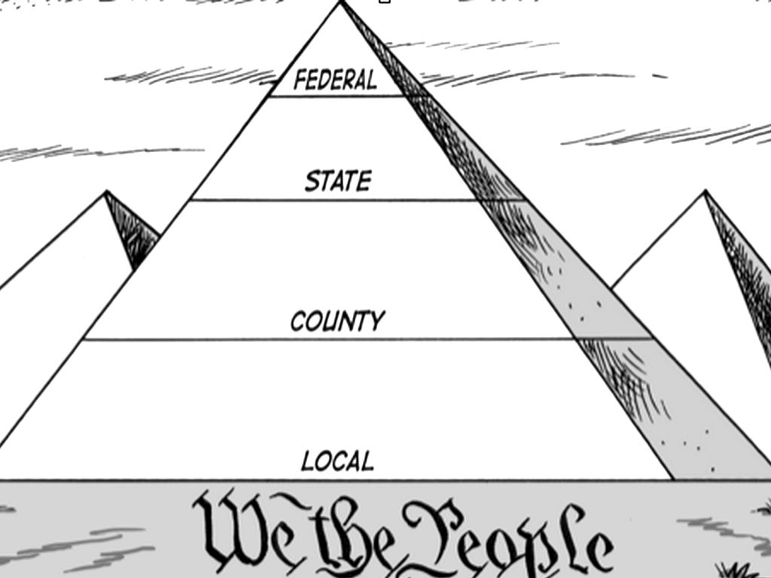
Understand which level of government you should contact
The system of government in which we follow in the United States is broken up into different levels. Be sure to research how the issue you feel is important impacts at each level.
It is important to remember that legislative officials at the state and the federal level are referred to as “Representatives” and “Senators” and that sometimes people can be confused by this.
Federal – President, legislators, Supreme Court Justices
State – Governor, legislators, Supreme Court Justices
County – Commissioner and other county elected officials
Local – Mayor (municipal) or Board President (school)

Slide 5
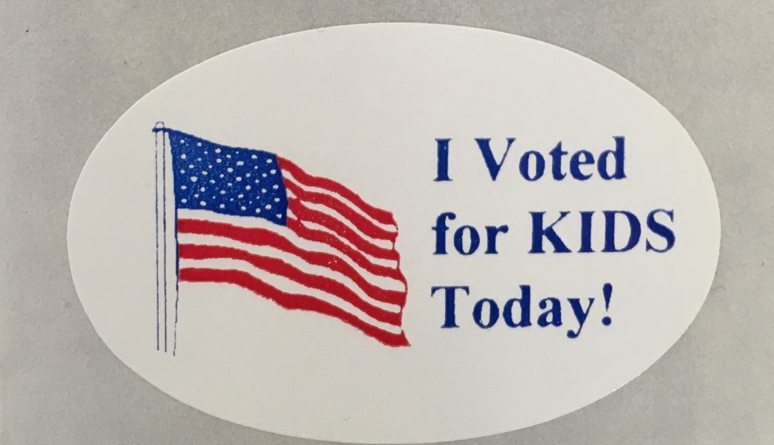
Every Two Years Voter Choose: | Every Four Years Voters Choose (Non-Presidential Years): | Every Six Years Voters Choose:
24 State Senators (half of the State Senate, even or odd-numbered seats) 101 State Representatives (entire State House of Representatives) 5 Members of Congress (entire U.S. House of Representatives) | 8 statewide officers: Governor Lieutenant Governor Attorney General State Treasurer Superintendent of Public Instruction Insurance Commissioner State Auditor and Inspector Labor Commissioner | 3 Corporation Commissioners 2 U.S. Senators (elected for six-year terms and elected on a staggered basis)
Elections in OK

Slide 6
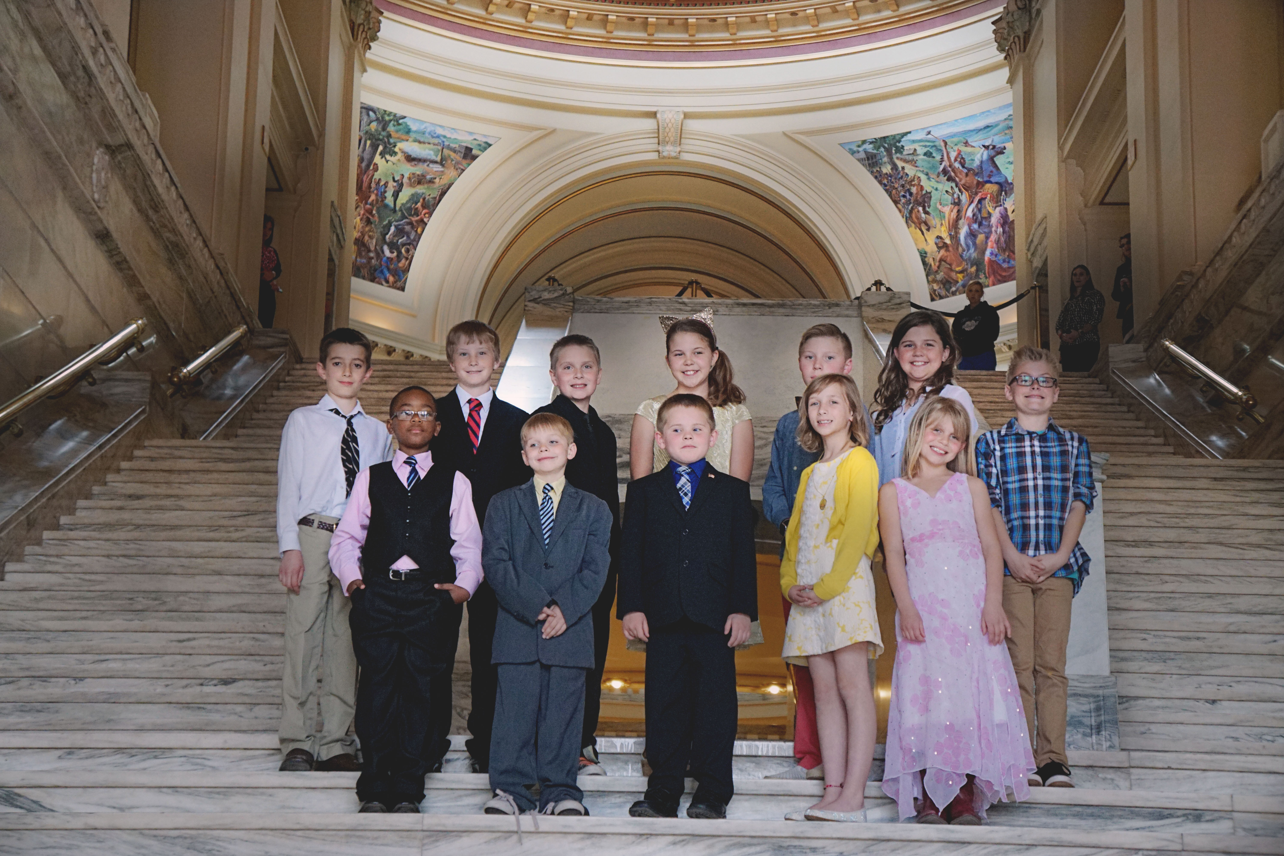
The Oklahoma LEGISLATURE
House of Representatives
101 Members
Two-Year Terms
Republicans have controlled the House since 2004
Current Breakdown: 81 Republicans / 20 Democrats
Presided over by Speaker Charles McCall
Senate
48 Members
Four-Year Staggered Terms
Republicans have controlled the Senate since 2008
Current Breakdown: 40 Republicans / 8 Democrats
Presided over by President Pro-Tempore Greg Treat
Lieutenant Governor Matt Pinnell is the President of the Senate

Slide 7
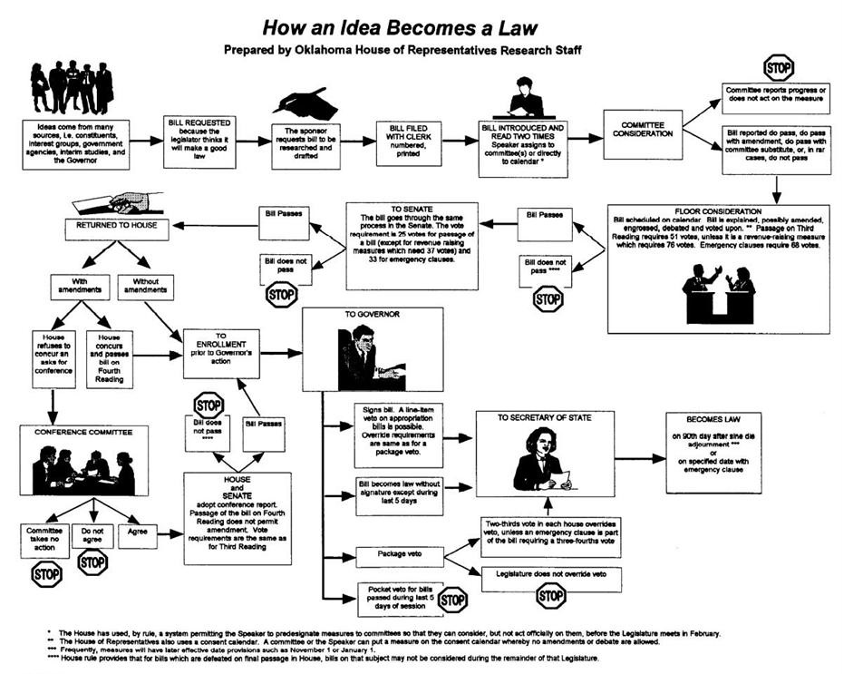
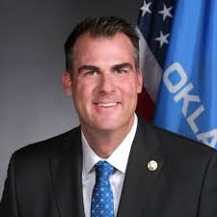
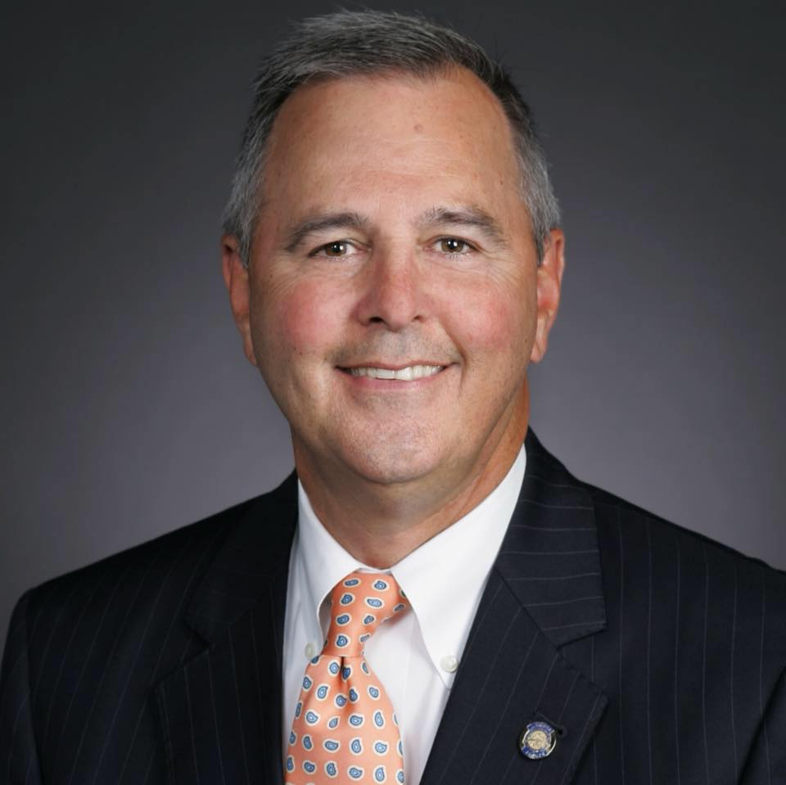
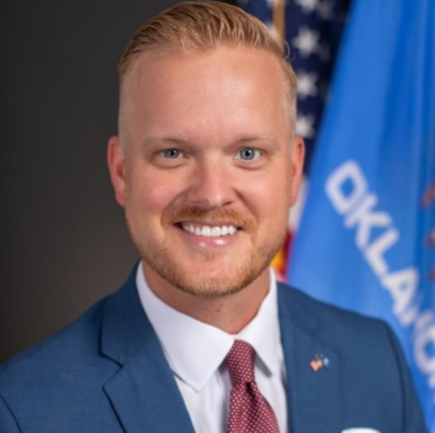
Path of LEGISLATION

Slide 8
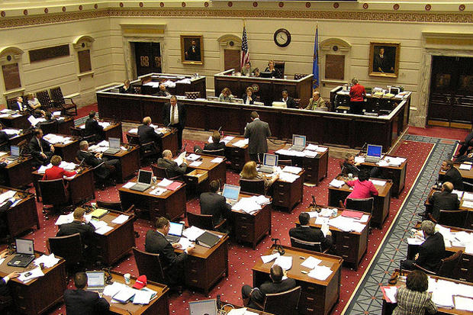
LEGISLAtive Calendar
Timeline for the Oklahoma Legislature
December – Bill request deadline for lawmakers
January – Organizational Day (odd-numbered years)
January – Bill introduction deadline for filing
February – Session begins on the first Monday (First & second reading of bills)
March – Third reading in House of Origin deadline (6th week)
April – Third reading in Opposite House deadline (12th week)
May – Conference committees meet, budget passed, Sine Die adjournment by final Friday
June through November – Interim studies - legislators are back home.
Take time to reach out to lawmakers in their districts to discuss ideas for policy

Slide 9
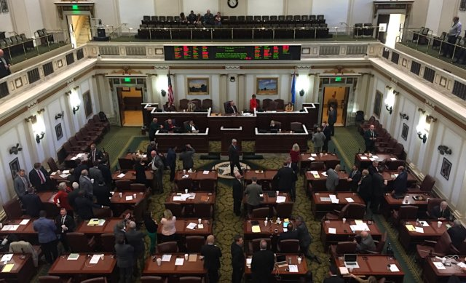
Types of Legislation
Legislation which originates in the Senate is numbered consecutively beginning with “1” and bills which originates in the House are numbered consecutively beginning with “1001”:
Bills
have the force and effect of law
must be passed by both chambers
must be signed by the Governor (except when the measure submits a question to a vote of the people)
generally proposes changes to the Oklahoma Statutes
Joint Resolutions
have the force and effect of law
must be passed by both chambers
must be signed by the Governor (except when the measure submits a question to a vote of the people)
(often will not become part of the Oklahoma Statutes)
Concurrent Resolutions
do not have the force and effect of law
must be passed by both chambers
are not signed by the Governor
will not become part of the Oklahoma Statutes
are used to express the will or opinion of both chambers
Simple Resolutions
do not have the force and effect of law
must pass only the chamber which introduced the measure
are not signed by the Governor
will not become part of the Oklahoma Statutes
are used to express the will or opinion of one chamber

Slide 10
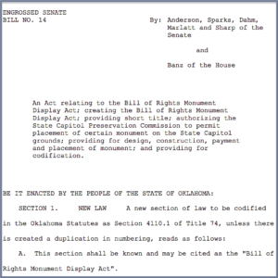
Reading a Bill
Measures being considered by the Oklahoma State Legislature pass through a variety of forms.
Introduced Version
The bill or resolution, as filed, is has the heading, “AS INTRODUCED”. The measure is introduced in this form and remains this way until it is reported out of committee in the first chamber.
Committee Version
After a measure has been heard by a committee and reported to the floor for further consideration, it is printed with changes made in committee highlighted in bold.
Engrossed Version
A verified copy of the bill or resolution, complete with any committee or floor amendments, is executed after Third Reading. An Engrossed Version passed by one chamber is filed for committee work in the second chamber, then in the same form as above for floor action.
Conference Committee Substitute
Frequently, bills pass the two houses in different forms and go to conference committees to have the differences resolved. A report signed by conferees and a conference committee
substitute that resembles the committee version will be considered by both chambers.
Enrolled Version
A verified, final copy of the identical bill or resolution passed by both chambers and ready for the Governor’s signature or veto is filed.
Bills being considered by the Legislature can do any one or any combination of the following:
Create new law
Amend existing law
Repeal existing law
Appropriate money or set budgetary limits

Slide 11
Budget timeline
January | February | March | April | May | June
On the first day of legislative session, the Governor Submits the Executive Budget to the Legislature for consideration | Legislature in Session |  |  |  | State agencies submit budget work program to Office of Management & Enterprise Services for approval
 | Legislative Review of State Agency Budgets; Passage of Budgets for State Agencies
 | Final Review of Available Revenue for Expenditure by State Legislature by the State Board of Equalization
 |  |  |  |  | June 30 End of Fiscal Year
July | August | September | October | November | December
July 1 Beginning of the new Fiscal Year |  | State agencies submit budget request to the Office of Management & Enterprise Services | OMES Reviews State Agency Budget Requests; House and Senate Committees Hold Agency Performance Review Hearings
 |  |  |  |  | Preliminary Certification of State Revenue by the State Board of Equalization for next year
The Legislature’ biggest job is the development of an annual state budget. Often, advocacy must impact a budget to impact policy. This is the timeline for the annual Oklahoma state budget.

Slide 12
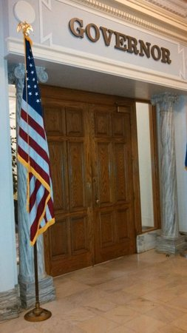
Powers of the Governor
Upon receiving a bill or joint resolution which has passed both chambers of the Oklahoma Legislature, the Governor may:
Approve the measure
*by signing it within five days from receipt during session
Veto the measure
*by returning it within five days (Sundays excepted) with objections
*the Legislature might be in Session, thereby providing an opportunity to override
Pocket Passage the measure (if passed prior to the last five days of a session)
*allows it to become law without action by the Governor by keeping it five days (Sundays excepted)
*the Legislature must be in Session
Pocket Veto the measure for bills passed during the final five days of a session.
*by keeping it up to fifteen days (Sundays excepted) without taking official action following the Legislative Session
Appropriations Legislation
The governor can line-item veto sections of the General Appropriations Bill which is passed annually by the Oklahoma Legislature. This allows the governor to have the ability to block programs in which the legislature has specifically provided additional funding and instead allocate those dollars to the general operations of that agency.

Slide 13
Executive branch
The Governor Serves as Chief Executive of the State
Elected to a four-year term, two-term limit.
Powers and Duties:
Head of state and chief executive for the State of Oklahoma
Commander in Chief of the Oklahoma National Guard
Appoints (with confirmation by the state senate) cabinet secretaries and various agency directors
Delivers yearly “State of the State” address to the Legislature on the first day of session
Governor J. Kevin Stitt (R)
Elected 2018
Re-elected in 2022

Slide 14
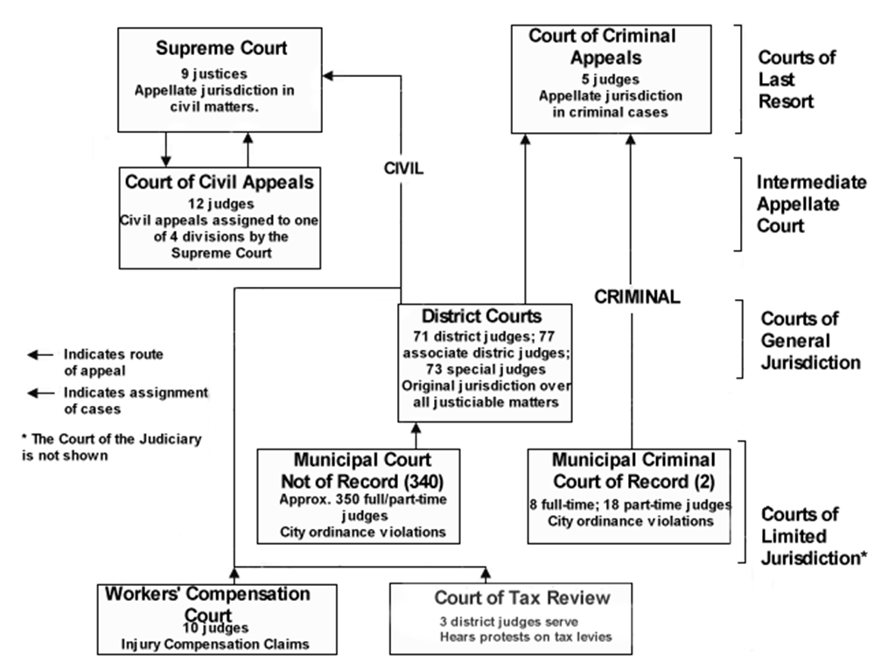
judicial branch
While not a target for traditional advocacy, sometimes advocacy issues end up in the courts, and it is important to know the state’s court system. The Oklahoma court system is different from all other states, with the exception of Texas, in that Oklahoma has two courts of last resort: the Oklahoma Supreme Court and the Court of Criminal Appeals . Source: OKHISTORY.org

Slide 15
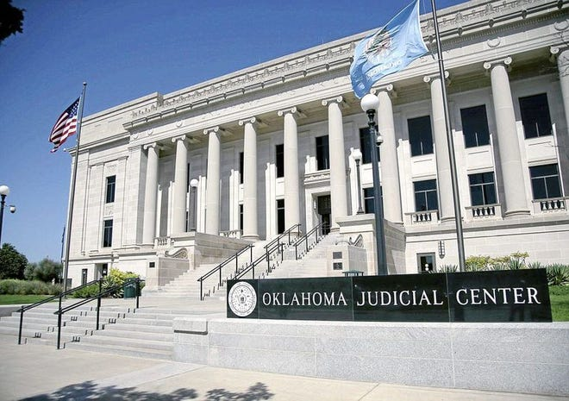
Supreme court cases
The nine Justices of the Oklahoma Supreme Court decide only civil cases.
The five Judges of the Oklahoma Court of Criminal Appeals decide criminal cases.
The Oklahoma Supreme Court has only immediate jurisdiction with respect to new first-impression issues, important legal issues, and cases of great public interest.
In addition to appeals from the trial courts, the Oklahoma Supreme Court has jurisdiction over all lower courts, excluding the Oklahoma Court on the Judiciary, and the Oklahoma Senate, when that body is sitting as a Court of Impeachment.
Judgments of the Oklahoma Supreme Court with respect to the Oklahoma Constitution are considered final.

Slide 16
Lobbying
Lobbying is Defined by Webster’s Third New Collegiate Dictionary as:
to conduct activities aimed at influencing public officials and especially members of a legislative body on legislation.
to promote or secure the passage of legislation by influencing public officials.
to attempt to influence or sway a public official toward a desired action.
There are Different Types of Lobbying:
in person usually at the legislator’s office back home in the district or at the Capitol.
by mail including letter or postcard, or in some cases, email.
by phone, and sometimes text message.
by social media through public or private message.

Slide 17
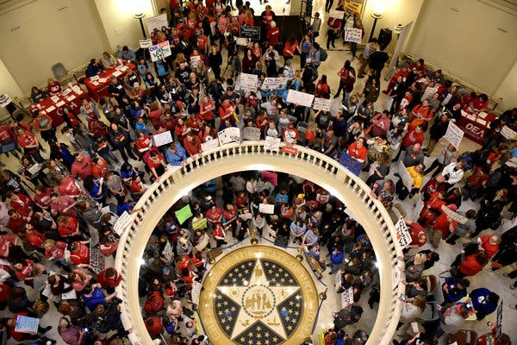
GENERAL RULES FOR EFFECTIVE LOBBYING • Contact your member organization for the latest information on issues, or the current organizational strategy, before contacting the legislator. • If you are a government or public school employee, do not use any public resources to lobby. Use a personal email or your own mobile phone and indicate that you are not “on the clock” with your work. • Always introduce yourself as a member of your association. A simple “May I have a few minutes of your time?” will set the stage if you have not scheduled an appointment. • Be gracious to the legislator’s staff assistant. A rude tone will affect your relationship with all in the office, including the legislator. Treat all staff with respect. • Get down to business quickly. Be brief, be direct, be simple and, above all, be accurate. Do not philosophize. Know your topic and be prepared for questions. Remember that your legislator hears many viewpoints. You want him/her to remember yours, so be factual.

Slide 18
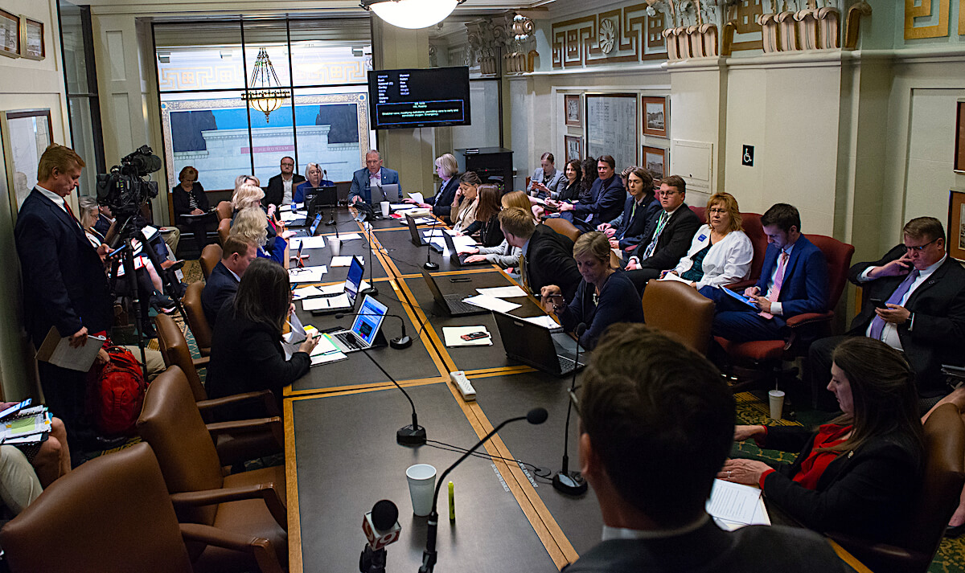
• Keep in mind that the legislator may try to lobby you. This is especially true if the legislator senses that there is not a firm commitment on the part of our members to our issues. This will hurt our lobby effort. • When finishing the conversation, always thank the legislator for his/her time. If he/she has asked for follow-up information, quickly send it with a note offering further assistance. Include your name and your local association/TSTA. • Don’t give up if you are not successful the first time. In fact, many times success is in just making the initial contact. Communications established through discussion can aid future lobbying efforts. • Keep in mind that many or most of the legislators have little or no direct knowledge or experience with the issue. For example ,with public schools, their expertise might be that they may have attended public school or their children are in school. A large part of your job is to help them understand what it is really like in a situation pertaining to the discussion.
GENERAL RULES FOR EFFECTIVE LOBBYING

Slide 19
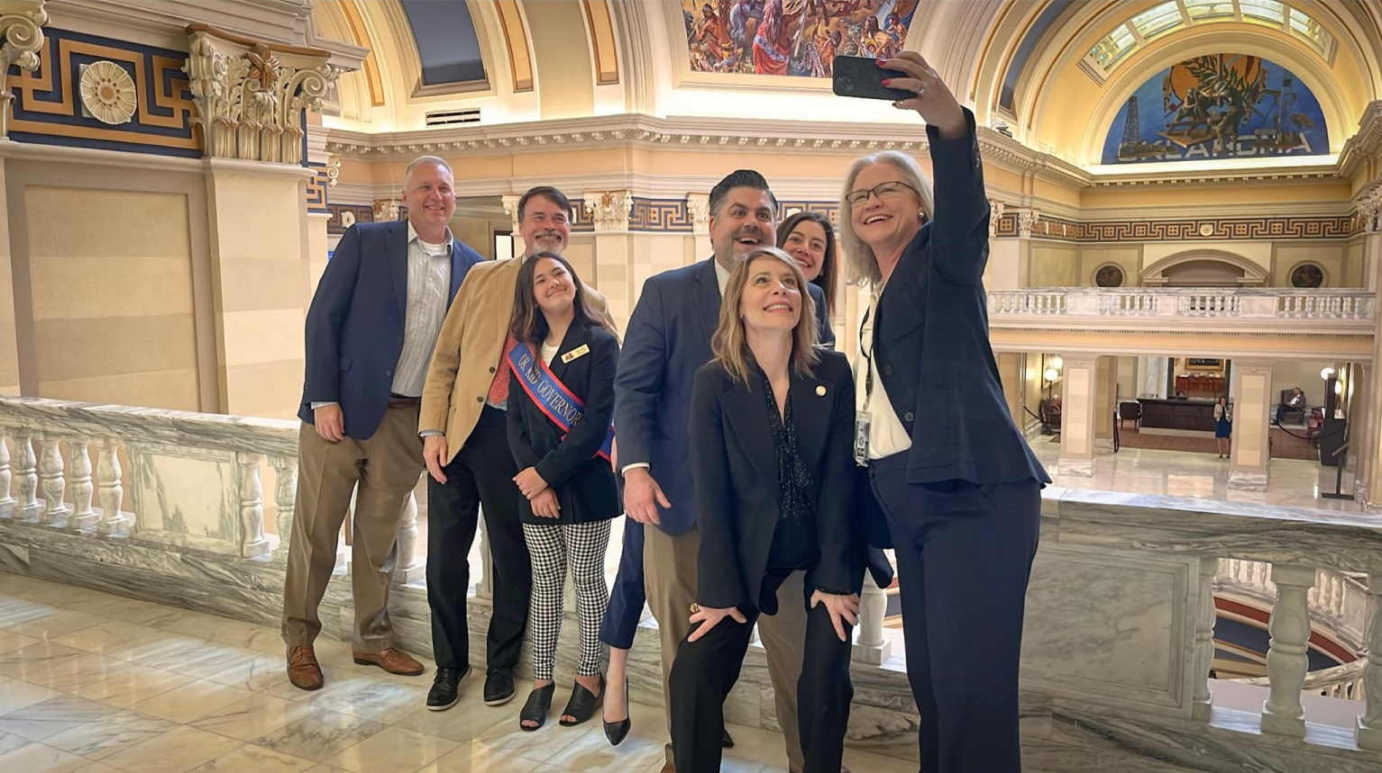
General Rules for Effective Lobbying
• Be friendly, be persuasive, be professional, and be courteous. Do not argue or belabor the point. Your role is to explain, inform and persuade. Do not threaten or attack. • Never make up a position for the association or give an answer to a question that you are not familiar with. The appropriate response is “I’ll get back to you with the answer.” Remember, the legislator is depending on you to give accurate information, not guess.
• Listen carefully to what the member is saying and write notes after the conversation so you do not forget important points.
• Though your appointment is with the legislator, due to their busy schedule, last minute changes may result in meeting with the legislator’s assistant. Do not be discouraged but cordially accommodate the change and make your presentation to the aide. Legislators’ assistants are very knowledgeable about the issues/bills going through the capitol. They are very influential with their legislator and can advocate our point of view. • Report your progress to your association by their preferred reporting system - mailing a reporting form, letter or brief note, or through a phone conversation.

Slide 20
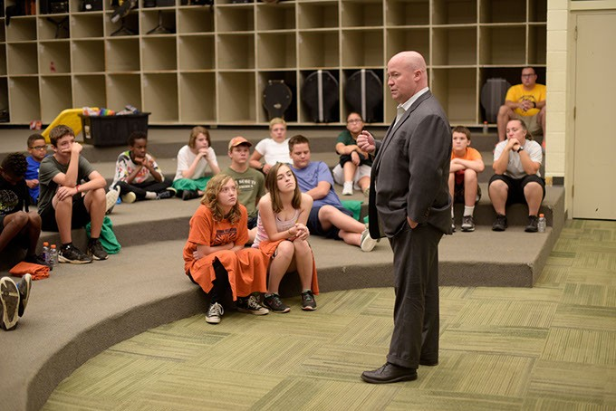
The Crucial 90-second pitch
“The pitch”
Memorize a quick “elevator pitch” before your meeting. It’s not only handy for talking to elected officials, but it will also serve you well when explaining your issue to media persons, fellow advocates, or anyone really.
Your speech should include
• Who you are and any group or coalition to which you belong.
• The topic you came to discuss.
• What you want them to do.
• A reference the fact sheet you have brought along.
Your fact sheet is crucial. If your meeting gets interrupted, you’ll still get your point across and the elected official will know how to find you or your group if they have further questions. If not, you can elaborate your points in your fact sheet.
It’s simple: Say what you mean and mean what you say. And, of course, keep it short and simple

Slide 21
Preparing for Advocacy
Now that you know the rules of the game, how can you be effective in communicating your message to policymakers? These five tips are suggested for you to use to make the most of your time, your knowledge and to be successful in your effort!
1) Prepare a Good Advocacy Fact Sheet
2) Utilize Social Media
3) Write a Letter to the Editor or Submit a Guest Commentary to your Local Newspaper
4) Make a Phone Call
5) Visit your Elected Official in Person

Slide 22
1. Prepare a good advocacy fact sheet
The purpose of a fact sheet:
• Present the facts: key statistics, figures or comparisons.
• Identify a group with a particular issue
• Provide answers to common questions about the issues (Fact sheets are often in a Q & A format.)
• Show information using graphs, charts, or pictures
• Inform, persuade or educate
• Make an argument for a particular policy
A good advocacy fact sheet:
• Is only one to two pages long
• Doesn’t use long sentences or wordy paragraphs
• Is easy to read, with sub-heads, bullet points and graphics
• Includes only the most compelling, useful statistics and does not exaggerate
• Has a specific call to action (Be clear about what you want readers to do.)
• Includes contact information of the organizing group
FIVE PRACTICAL ADVOCACY TOOLS

Slide 23
Five practical advocacy tools
2. Utilize Social Media
A tweet with the right hashtag; a Facebook event page, status change or well-promoted update; an Instagram photo can speak a thousand words; or a blog discussion can generate a virtual “buzz” that manifests itself into true momentum. If you are not using social media to promote your cause, START!!!
Good news about social media: It’s FREE!
• Ease and accessibility for everyone - mobile devices, Wi-Fi, etc.
• Speed in creating awareness - quick check online gets attention
• Connections and reach of the posts - broad scale for target audiences
Challenges of social media: Social media is often misused because many advocates are unaware of how to efficiently and effectively get a simplified but powerful message out to the public!

Slide 24
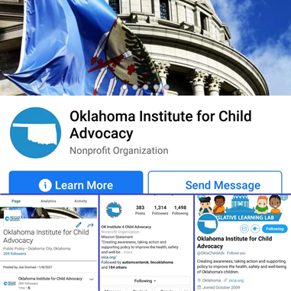
FIVE PRACTICAL ADVOCACY TOOLS
2. Utilize Social Media, continued
Tips for better results:
• Know who to follow and how to get followed.
• Make your posts relevant and concise.
• Properly use mentions, Twitter handles of others and hashtags for specific buzz.
• Be sure your social media posts are engaging followers in conversation. Ask them specific questions or prompt them to post pictures. It’s not just about your number of likes or followers, but that people are involved in your social media discussions.
• Remember, practice makes perfect. Just maintain a constant social media presence and you’ll get better at it each day.
KEEP YOUR COOL WHEN DISCUSSING ADVOCACY ISSUES ON SOCIAL MEDIA!!!!

Slide 25
Five practical advocacy tools
3. Write a Letter to the Editor or Submit a Guest Commentary to your Local Newspaper
Every Oklahoma newspaper publishes letters to the editor. While we know only a small percentage of newspaper readers scan the Editorial page, 100 percent of your community’s decision-makers read every editorial, guest column and letter to the editor.
Key Tips for Successful Letters to the Editor and Guest Commentary
• Use e-mail.
• Refer to a recent news article or editorial in the first sentence of your letter.
• Keep your letter concise: 4-5 paragraphs, 2-3 sentences each.
• Do not take shots at political leaders by name.
• Give readers a chance to understand your stake in the issues without getting too personal.
• Never miss a chance to say “Thank You” to a business leader, civic volunteer or political official who has provided extraordinary service.
• If you have more to say than a letter permits, you may consider submitting a guest column. Call the editorial page editor and ask for the paper’s specifications (re: length limitations and best timing for submittal). You may e-mail a photo as well, if requested. Make sure the photo is a current, clear and well-composed headshot.

Slide 26
five Practical advocacy Tools
4. Make a Phone Call
You can call elected officials at their office or contact them at home. They represent you and should be easily accessible to you. Lists of local elected officials, including school board members, city council members, state legislators and statewide elected officials, can often be found on government websites:
Tips for Calling Your Elected Official:
• Identify the issue you wish to talk about by name.
• Briefly state your position and how you would like your elected official to vote.
• Ask for your elected official’s stance on the issue.
• Don’t argue if the elected official has an opposing view or hasn’t yet decided.
• If you don’t know the answer to a question, do not guess. Simply say you don’t know, but that you will find out and get back with her/him with the information.
• If elected officials or their staff need more information, supply it as quickly as possible.
• Never be abusive or use threats.
• Follow up your call with a note restating your position and thanking them for their time.

Slide 27
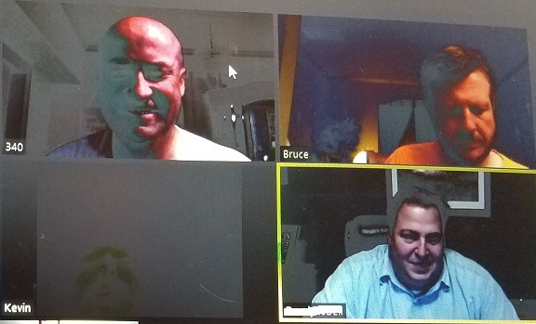
five Practical advocacy Tools
Make a Phone Call, continued
Elected officials are often away from the office, so you may end up talking with a staff person instead. That’s great! Use the same basic rules. Staff members are reliable and will pass along your message.
Many elected officials will publish their personal phone numbers. Respect their time after hours by calling at appropriate times!
Tips for Using Voicemail:
• State your name and address to identify if you are a constituent.
• Identify the specific issue you are calling about.
• Briefly state your position - either support, opposition or some combination.
• Keep the message simple.
Conversation via online platforms
In these days of online meetings, be willing to have that conversation online if the lawmaker prefers. Be sure to dress presentably and have a background that is professional

Slide 28
five practical advocacy tools
5. Visit your Elected Official in Person
Personal visits are a highly effective way to help elected officials understand your position on an issue. Elected officials welcome visits from constituents. They want you to be involved. However, they are busy people so time is extremely valuable. Plan ahead and use the time well. If you make an appointment, remember there is no guarantee the elected official will be able to keep it. Their schedules can change at a moment’s notice. Don’t take it personally - that’s just how it is.
Before the Meeting:
• Make an appointment in advance and expect to get about 15 minutes.
• Make it easy for your elected official to meet with you. Offer several possibilities and do your best to accommodate them – in office or in district.
• Prepare a good fact sheet (refer to Advocacy Tool #1).
• Try to learn in advance where your elected official stands on your issue. They may have their own websites, Facebook pages or Twitter profiles.
• Be prepared to explain how the issue will affect you and other voters in their district.
• Dress for the appointment. Normal business attire is appropriate.

Slide 29
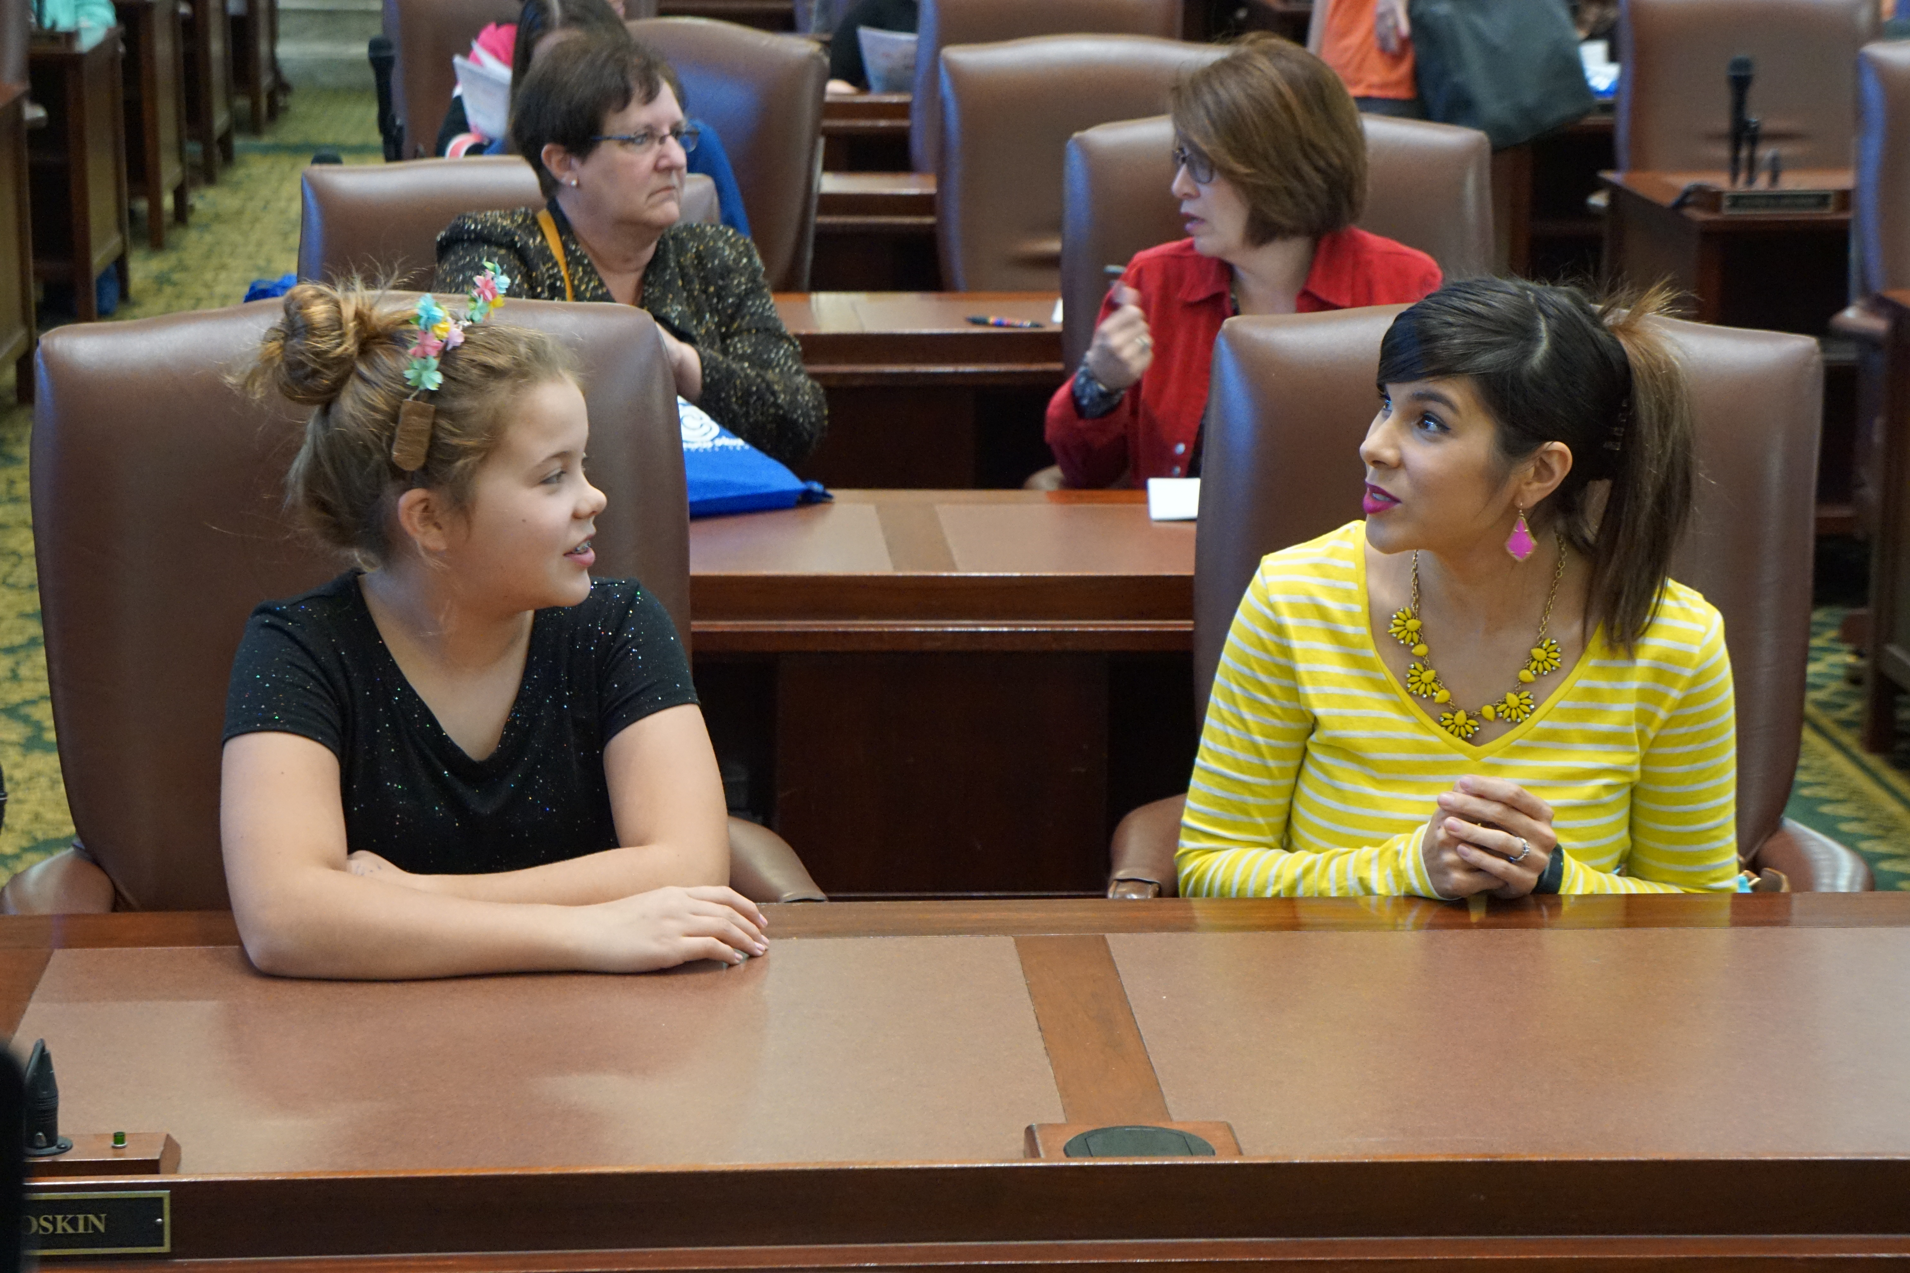
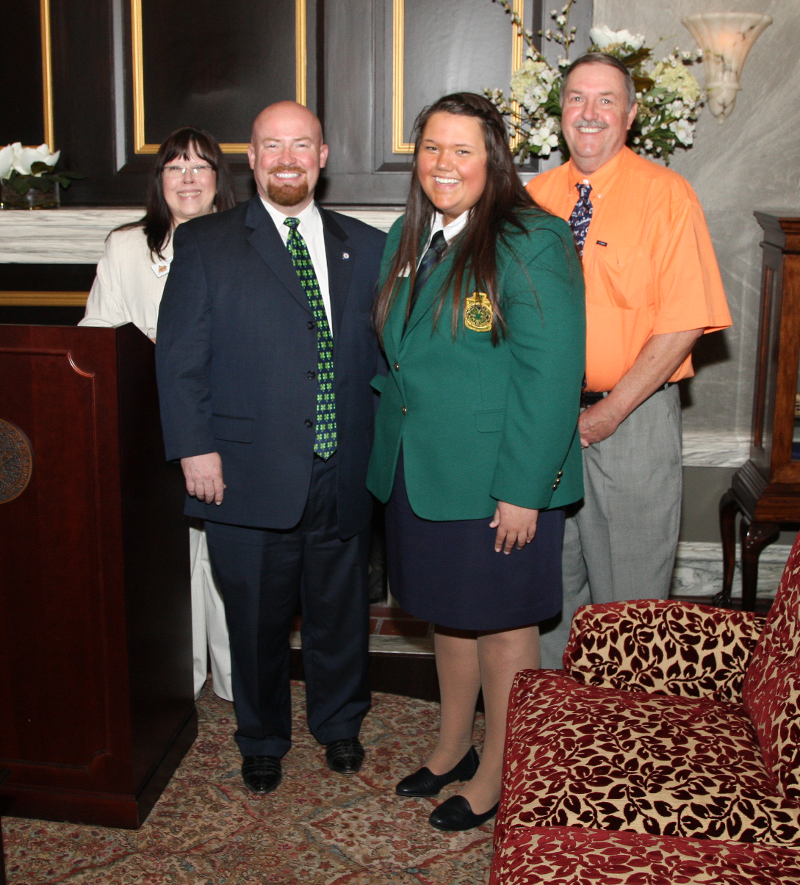
five practical advocacy tools
5. Visit your Elected Official, continued
During the Meeting:
• Be on time.
• Be prepared, polite and brief.
• Start with your 90-second speech.
• Give the elected official your fact sheet.
• Be firm but friendly. Don’t be afraid to ask for a commitment to support your bill.
• Attack the issue, not the person. Remember - you may be asking for her/his support on a completely different issue in the future.
• Don’t disparage government or politics.
• Don’t use jargon, technical terms or acronyms.
• Don’t underestimate public officials. With very rare exceptions, they are honest, intelligent and good-hearted people.
• Before leaving, ask how you can be of help to them. (Can you get them more information? Talk to others?)
• Thank them for their time, even if they will not support your cause.
After the Meeting: Follow up with a thank you note and any information that was requested.

Slide 30
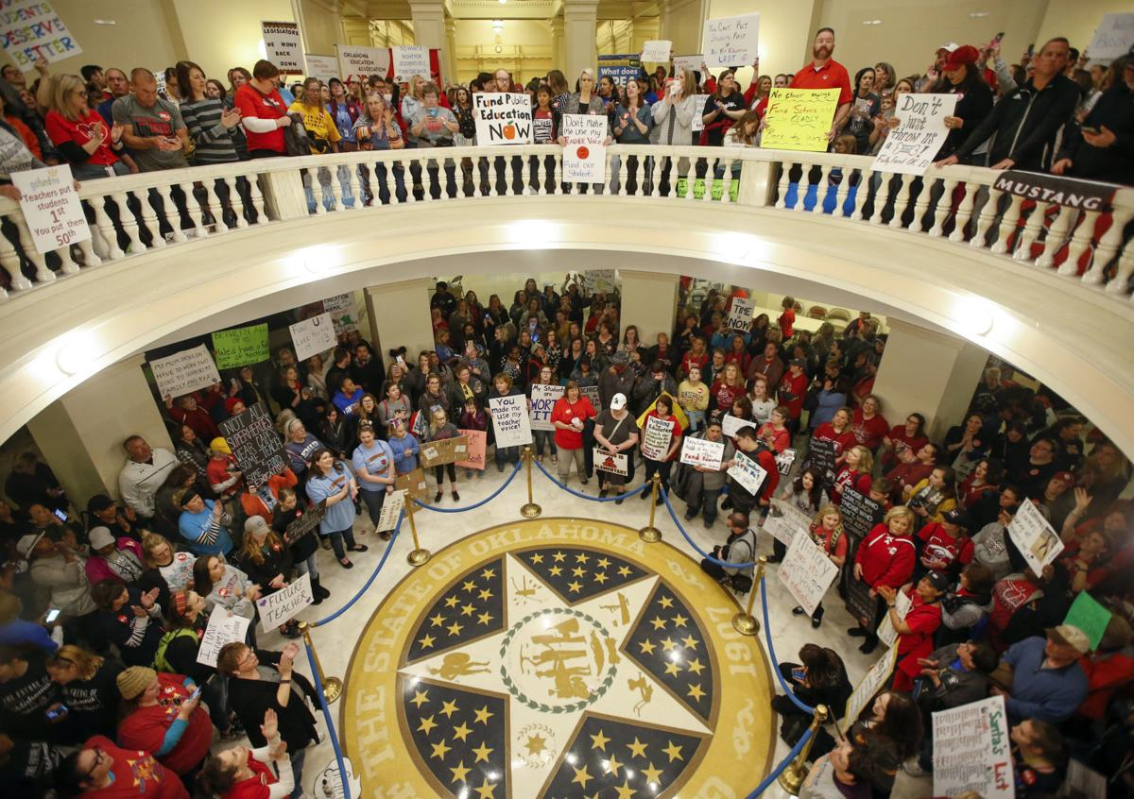
INTERVIEW TIPS WITH THE PRESS
Be aware that when lobbying or advocating for an issue, reporters will want to highlight a personal aspect of an issue. They rarely cover stories without a person to go on camera or “on the record” for an issue.
It is extremely important to be well-versed on the topic, or provide the reporter with the appropriate person who can best communicate the issue.
When working with an association on an issue, ensure the association has provided the talking points and provide the relevant connection for a personal side to the story.

Slide 31
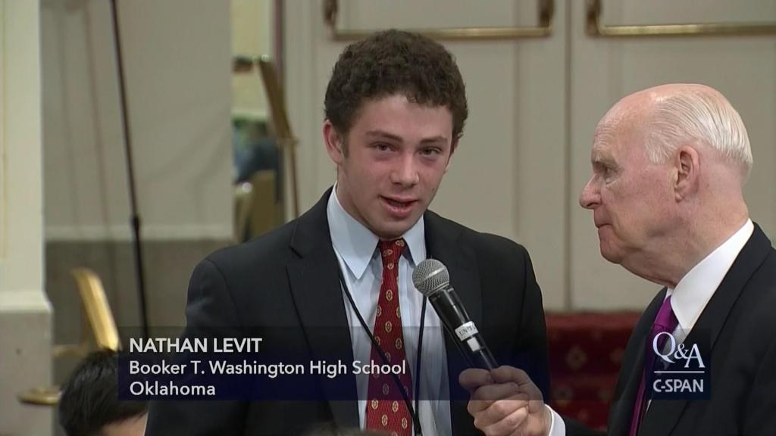
Interview tips
BEFORE THE INTERVIEW
You may find yourself in a position which needs an interview from a reporter regarding the issue. Here are some tips for a successful interview.
• Develop a sound bite - take home message that is short, sweet and to the saying your sound bite so you feel comfortable using it in conversation.
• Develop 2-3 key points to discuss about the topic.
DURING THE INTERVIEW
• Keep the interview conversational.
• Make eye contact with the reporter or interviewer. For televised interviews, do not look at the camera.
• Always give honest answers.
• Communicate your main message within the first 30 seconds of an interview, if possible.
• Stay on topic. Do not allow yourself to go on a tangent, regardless of what question is asked.
• Avoid jargon and the use of extensive statistics in your answer.
• When providing a website or phone number, give the information twice...s-l-o-w-l-y.
• Beware of the uhms, uh-huhs and nervous laughter. They will distract the audience.

Slide 32
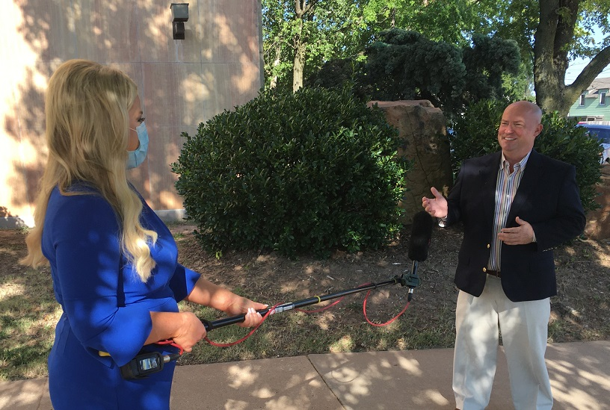
Interview tips
OTHER KEY INTERVIEW POINTS
Be early to your interview.
Talk in brief, complete thoughts while using terms that are easily understood by all. Also, do not sway if on camera, and do not keep your hands in your pockets.
Dress for success!
Be confident! Remember, you are the expert.
Anything you say can be used. There is never an “off-the-record” moment.
Be enthusiastic! Show your genuine passion for the topic.
Keep it local. People care more about what’s happening where they are.

Slide 33
Some of the OICA bills for 2024
HB1028 Tally(H); Rader(S) S Prohibiting use of corporal punishment on certain students. (SUPPORT)
HB2012 Bennett(H); Stanley(S) S Hope Shaffer Act; provide notice to parents about drivers education classes. (SUPPORT)
HB3329 Roe(H); Stanley(S) S Requiring certain schools to make menstrual products available at no cost to students; effective date. (SUPPORT)
SB1324 Thompson(S); Lawson(H) H Creates a universal electronic application for free and reduced-price meals for Oklahoma students. (SUPPORT)
TBD – Bill numbers
Mandatory acceptance of federal funding to implement summer food assistance for free and reduced lunch recipients
Wallace (H); Thompson(S) Appropriations to continue support for the Double Up Bucks SNAP subsidy, Family Representation and Advocacy Program (FRAP), and expanded support for CEP programs

Slide 34
Other work done by OICA
The Oklahoma Institute for Child Advocacy is currently working on two grant-driven endeavors.
Increasing awareness about SoonerCare enrollment across 20 rural OK counties through outreach in schools and daycares.*
Outreach to lawmakers for policies to reduce the need for group homes use for housing young Oklahomans.
* To request brochures for distribution, contact Joe Dorman at jdorman@oica.org

Slide 35
Become a member of OICA and help support our mission! Go to https://oica.org to learn more!
Every child deserves a chance. Stand with us in the fight for Oklahoma’s children by becoming a member of OICA today and joining the fight on behalf of Oklahoma’s kids and families.
Members help us to:
Reduce child hunger;
Help place foster children in loving and safe homes;
Reduce Oklahoma’s rates of abuse and neglect;
Support quality public education;
Reform and improve our criminal justice system;
And more!
Membership levels
Educator/Student/Govt. Employee - $60
Partner organization - $100
Individual - $120
Junior Executive Business Council - $500
Executive Business Council - $1,000

Slide 36
joe dorman, ceo Oklahoma Institute for Child Advocacy 2915 n. Classen Blvd., Ste 320 Oklahoma City, OK 73106 405.236.5437 Jdorman@oica.org website - oica.org

